Slide 1
KEEP TRACK
GIFT-LIST ORGANISER

Slide 2
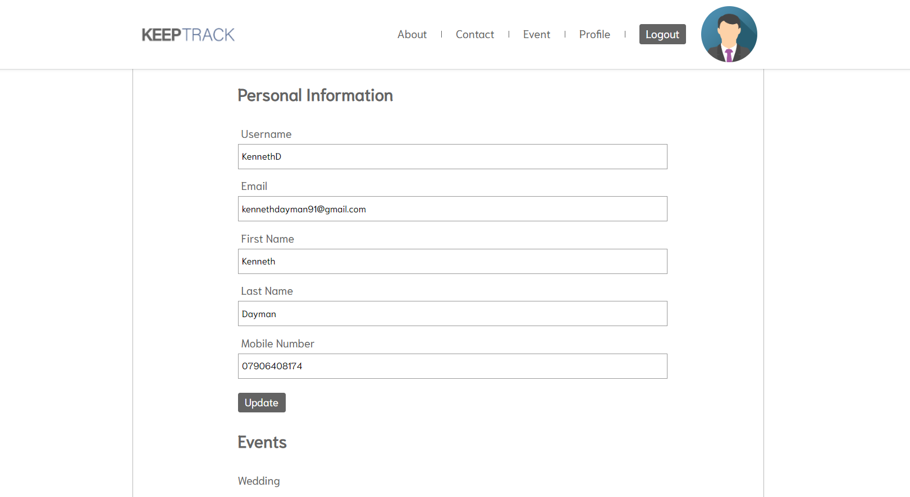
MVP

Slide 3
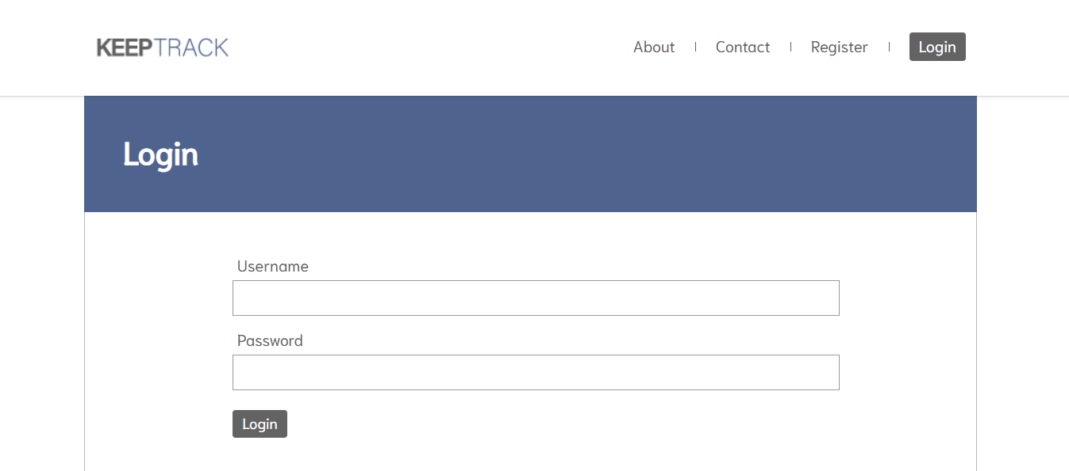
Deliverables
Navigation
Node JS Integration
Registration Page
Sign in Page
User Area
Event Page
Good Quality Design

Slide 4
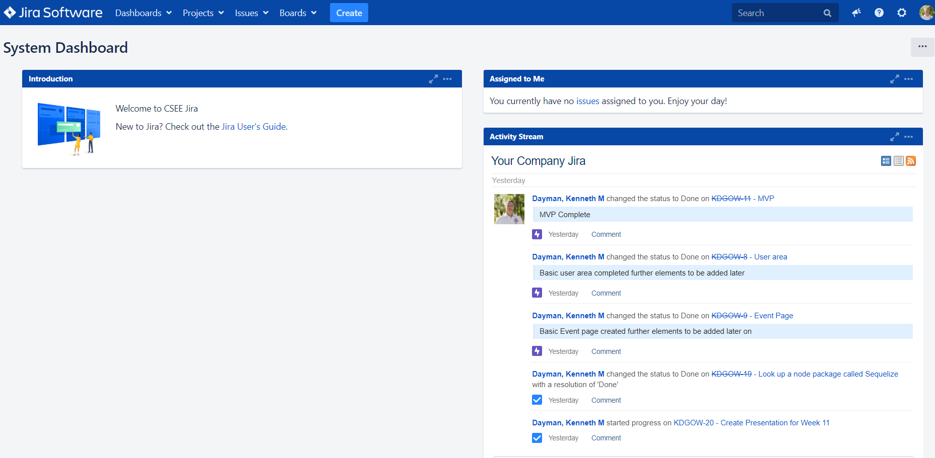
Jira
Kanban & Issues

Slide 5
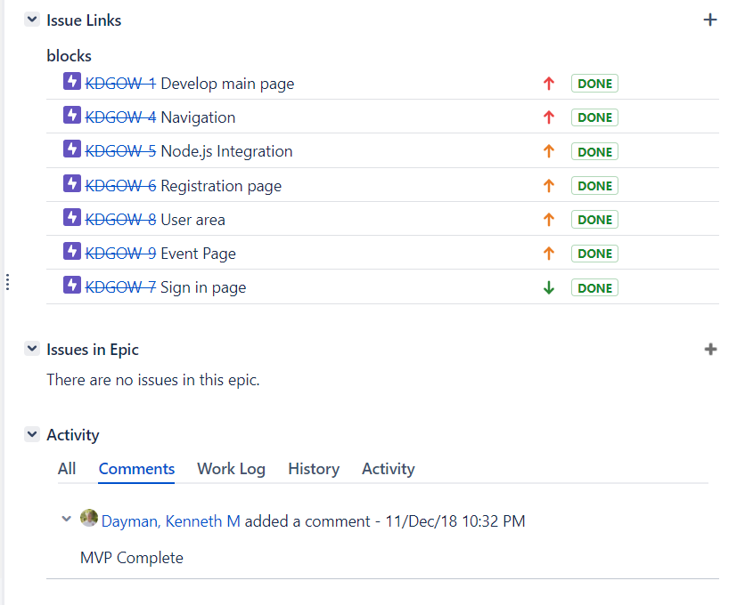
Kanban Board
Deliverables added as an Epic
Each Epic included in the MVP
Additional Tasks linked with Epic
MVP Epic Figure

Slide 6
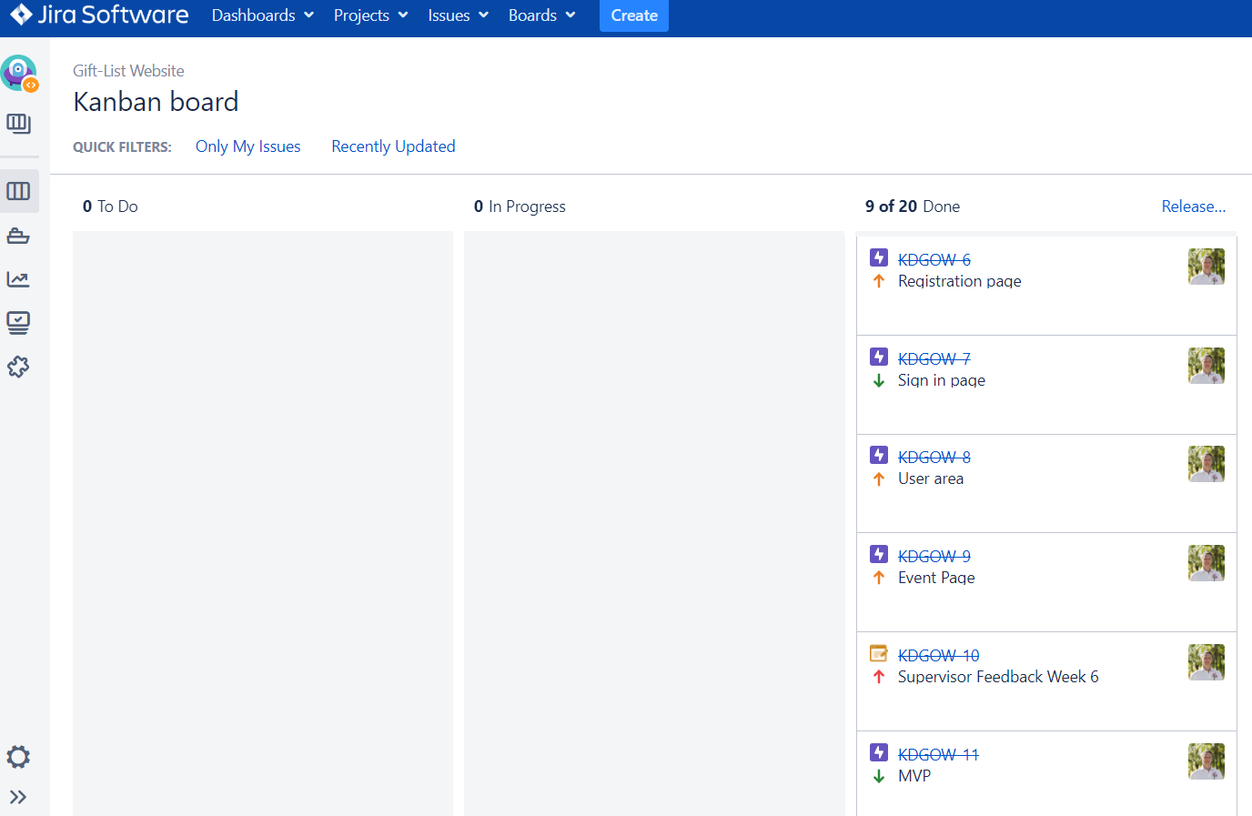
Kanban Board
All Epics and Tasks Completed
Additional Epics and Tasks to be included over Christmas and the start of the new term

Slide 7
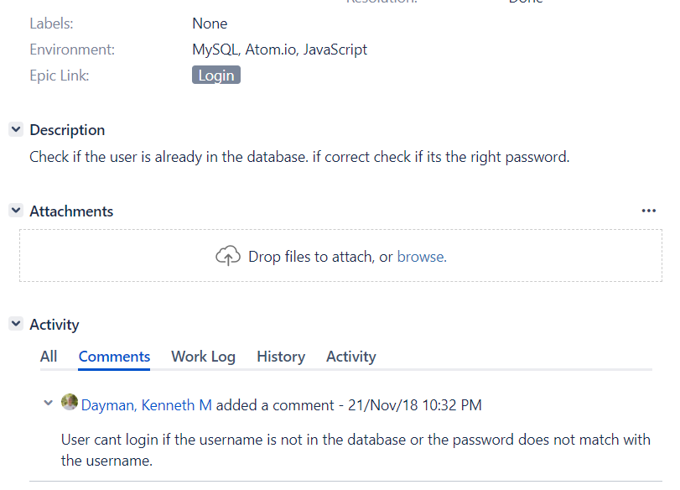
Kanban Board
Jira Interface has been used
Environment, Description and Comment have been used
Understanding Jira and Issues and Tasks

Slide 8
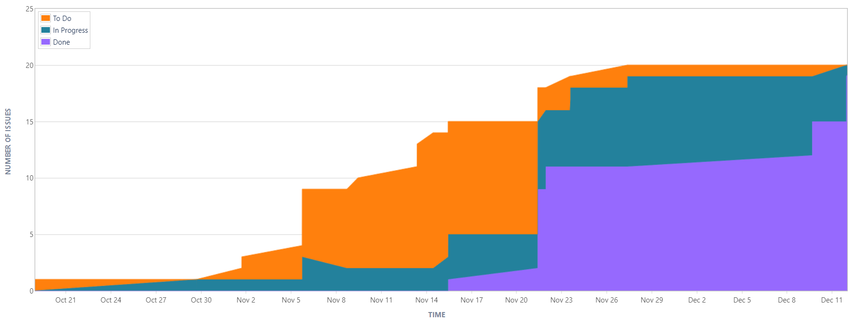
Kanban Board
Clear increase in Tasks and the progression that was made in the time period

Slide 9
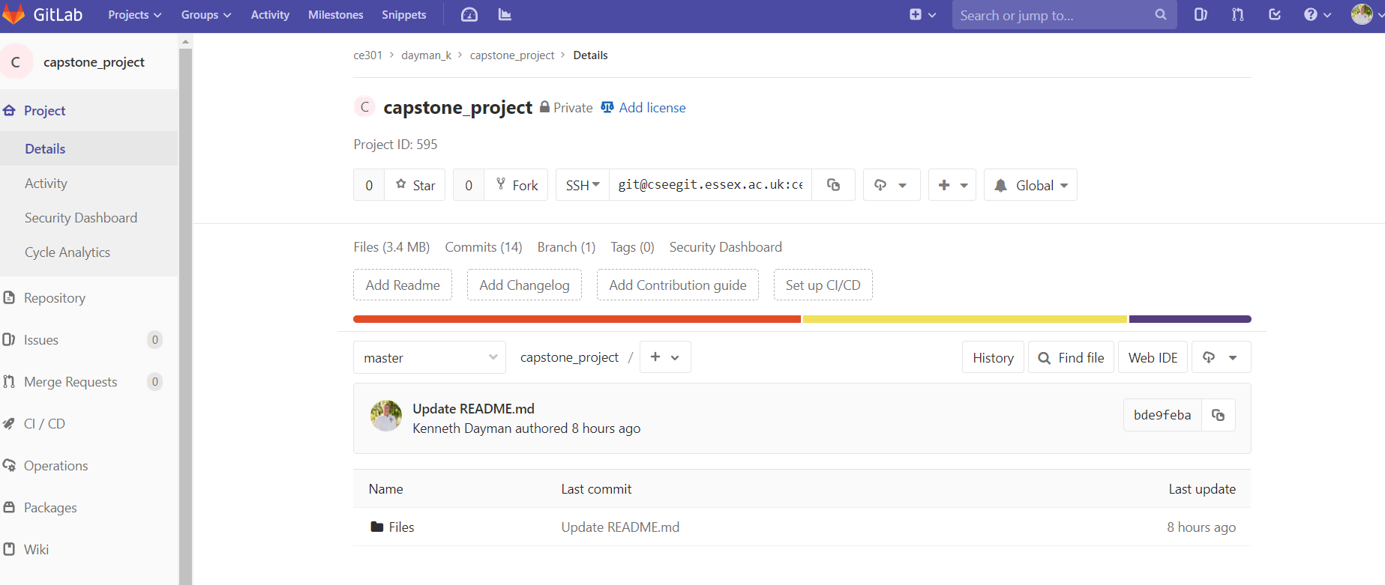
GitLab
Commits & Documentation

Slide 10
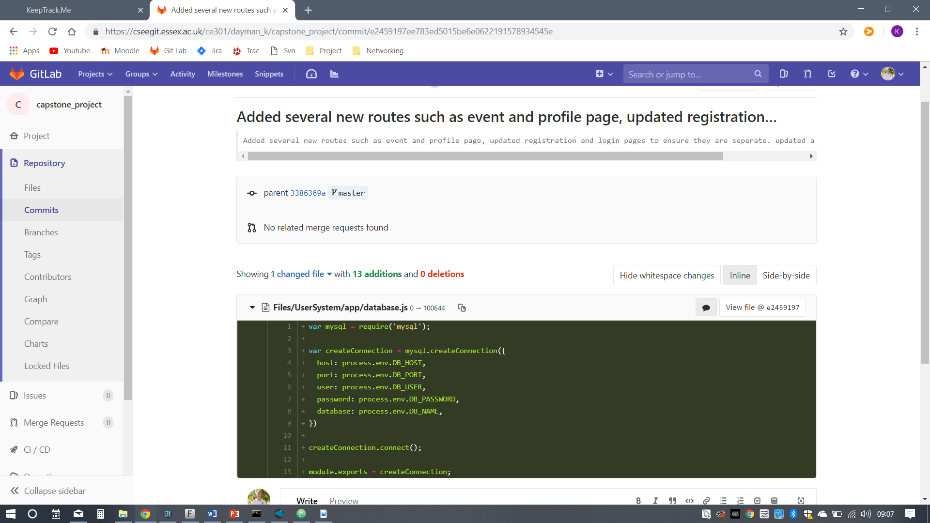
GitLab Commits
Commits have been made to the GitLab Server
Comments are included in the Commits
More Commits to be achieved

Slide 11
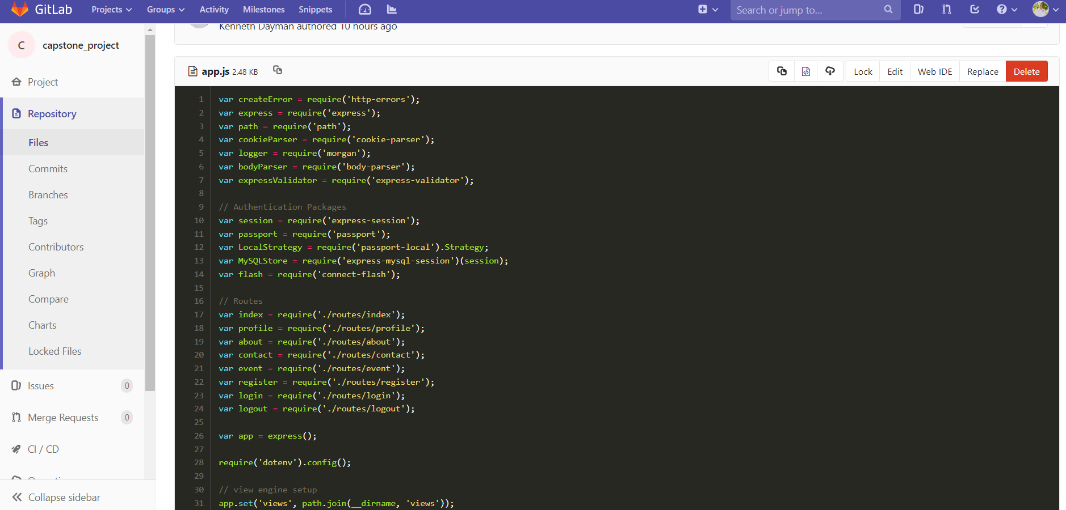
GitLab Commenting Code
Comments have been included in the code where necessary
Keeping code clean and suitable

Slide 12
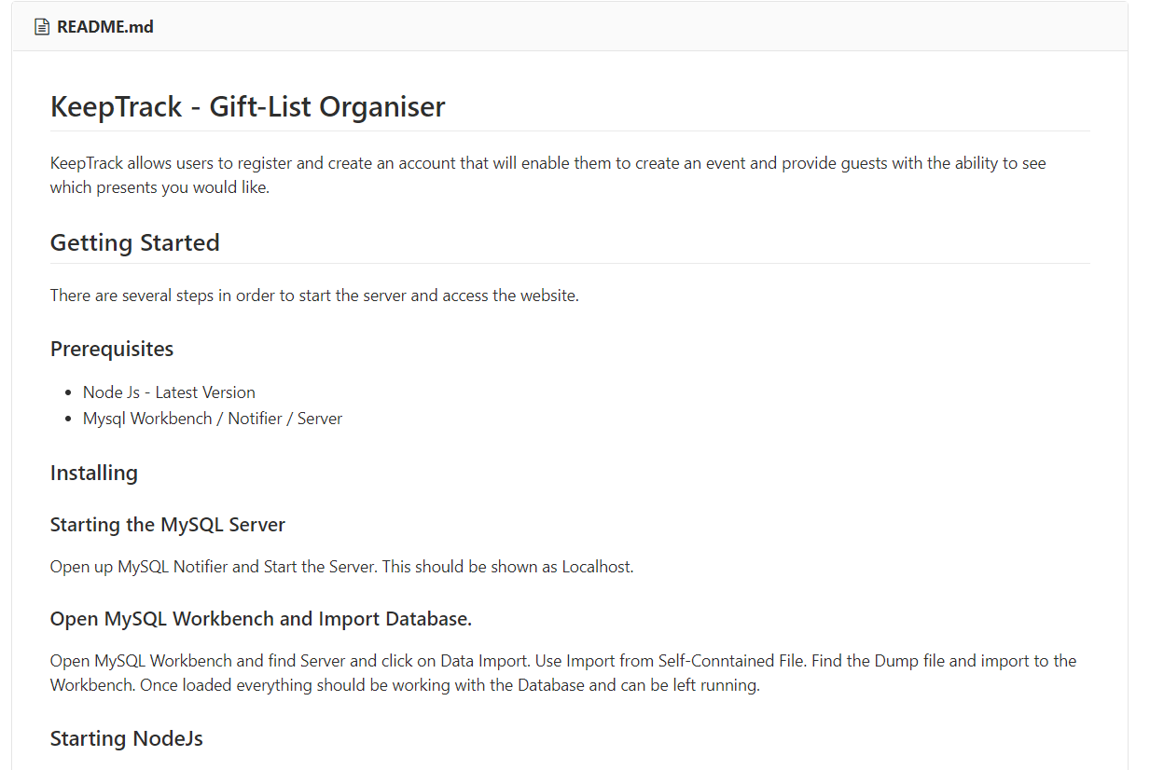
GitLab Documentation
A Up to date README.md
Placed on the GitLab
Provides a guide on how to get the Website up and running with certain software

Slide 13
Thank You

